Slide 1
Robotics Club Purwanchal Campus Day 7
Sadanand Paneru
BEI 075

Slide 2
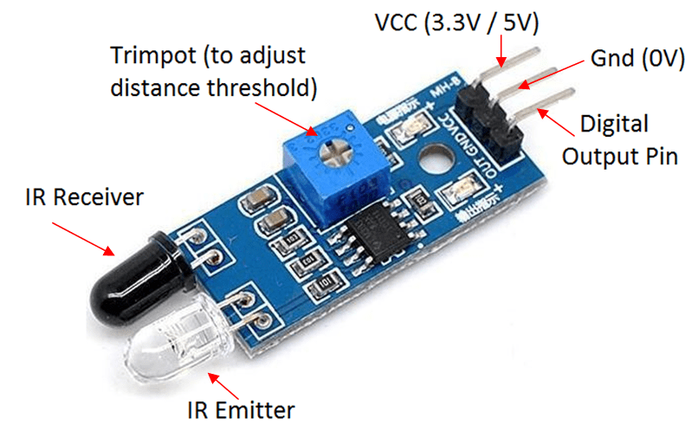
IR Sensor

Slide 3
Introduction
Infrared (IR) Sensor Module is a distance proximity sensor.
The clear LED is the IR emitter
The black LED is the IR receiver.
It uses the electromagnetic reflection principle where when the reflective surface is closer, the receiver will receive stronger signal.
This sensor module only able to detect distance between 2cm and 30cm
Based on Planck’s Radiation Law

Slide 4
Types of Infrared Sensor
Active Infrared Sensor
Passive Infrared Sensor
Transmitter
Receiver
Led and leaser
Receiver
Object as source

Slide 5
How Infrared Sensor Works
IR source (transmitter) is used to emit radiation of required wavelength.
This radiation reaches the object and is reflected back.
The reflected radiation is detected by the IR receiver.
The IR Receiver detected radiation is then further processed based on its intensity. Generally, IR Receiver output is small and amplifiers are used to amplify the detected signal.

Slide 6
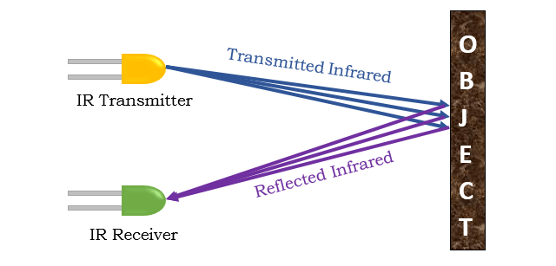

Slide 7
Application
Line following Robot
Item Counter
Radiation Thermometers
Human Body Detection

Slide 8
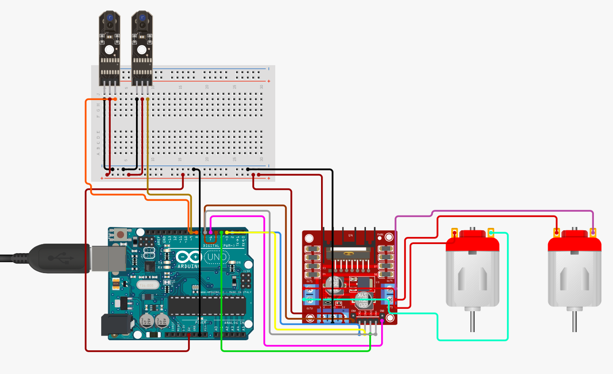
Circuit Diagram

Slide 9
Let’s Make line Following Robot
Thank You

